Slide 1
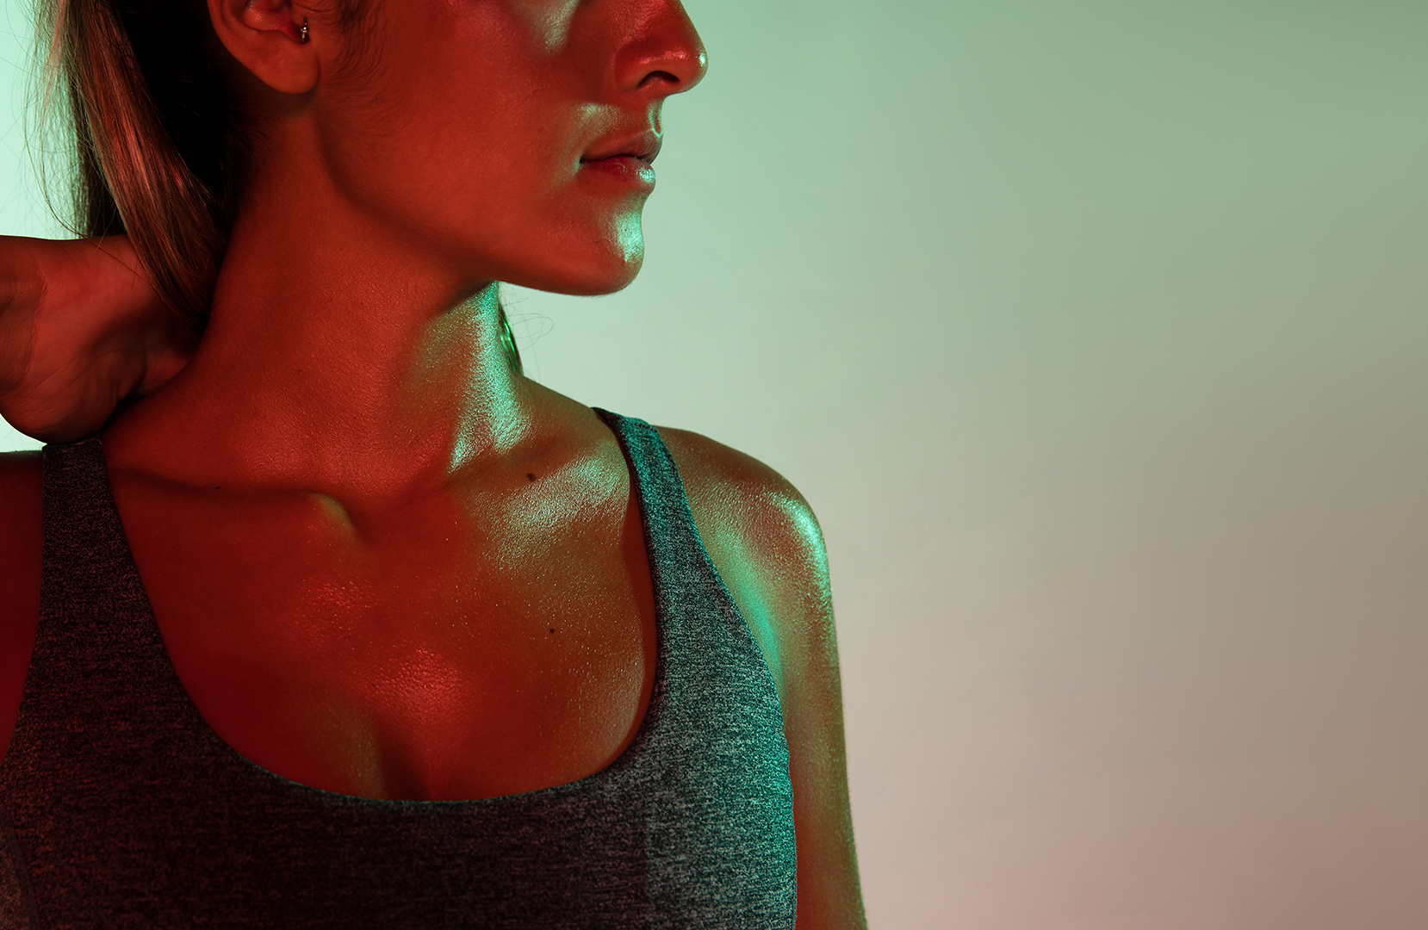
EXERCISE RECOMMENDATION SYSTEM
GROUP - 03

Slide 2
01
02
03
TABLE OF CONTENTS
04
05
06
INTRODUCTION
FEATURES
BLOCK
DIAGRAM
ALGORITHM
CONCLUSION
RESULT & DISCUSSION

Slide 3
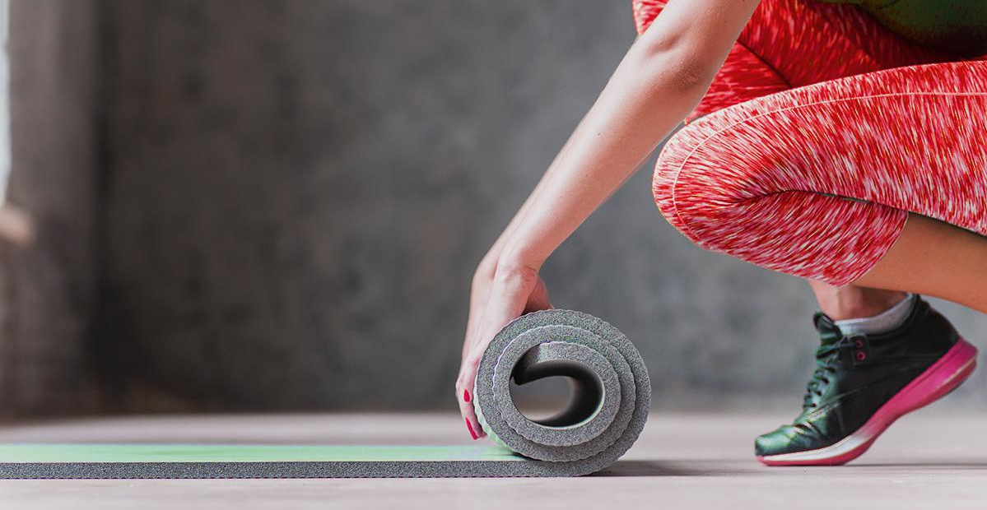
PROBLEM STATEMENT
The problem addressed in this project is the difficulty individuals face in selecting suitable exercises that align with their preferences.
WHY
By using multiple algorithms and combining lots of data to form a large dataset
HOW
This project is to develop an exercise recommendation system that utilizes data science techniques to provide multiple exercise suggestions.
WHAT

Slide 4
01
INTRODUCTION

Slide 5
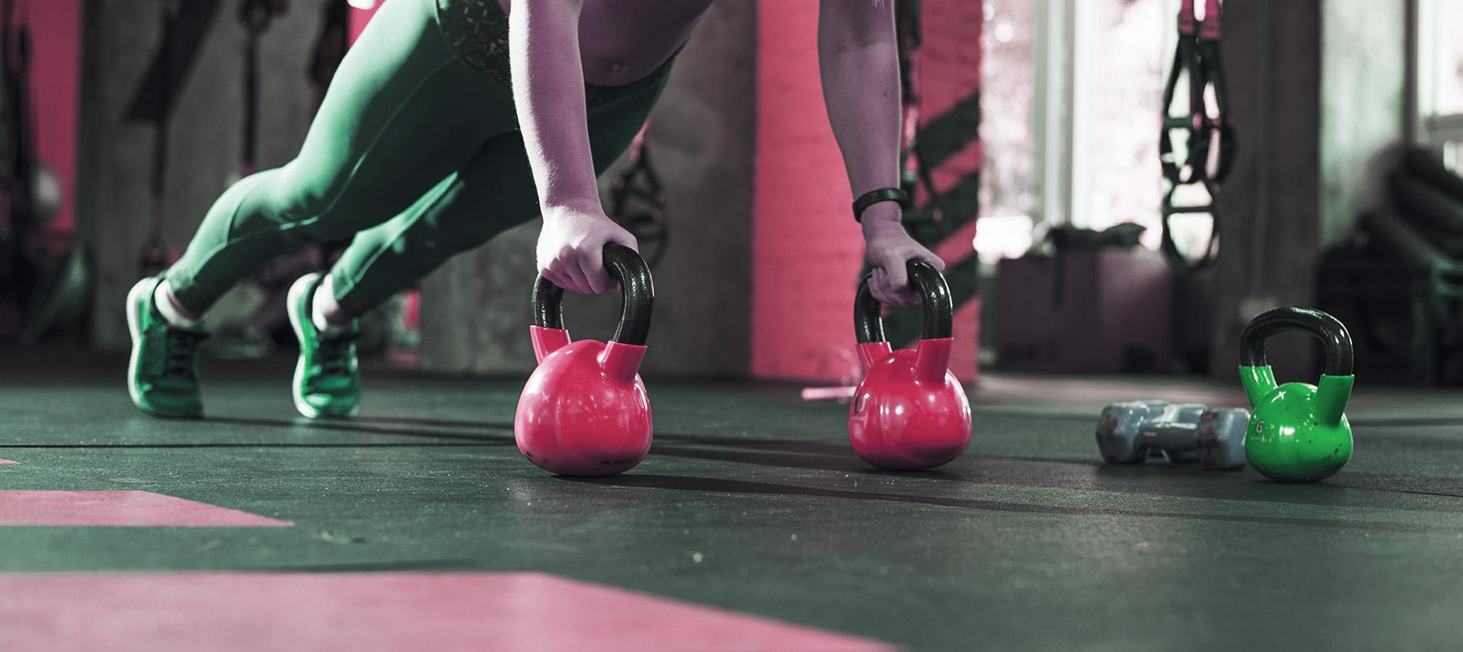
INTRODUCTION
FITGENIE
FITGENIE is a user-friendly website that provides a wide range of gym exercise recommendations. With its personalized workout plans, FITGENIE helps individuals achieve their fitness goals. From strength training to cardio, FITGENIE offers multiple suggestions to optimize your time at the gym and enhance your fitness journey.

Slide 6
02
BLOCK DIAGRAM

Slide 7
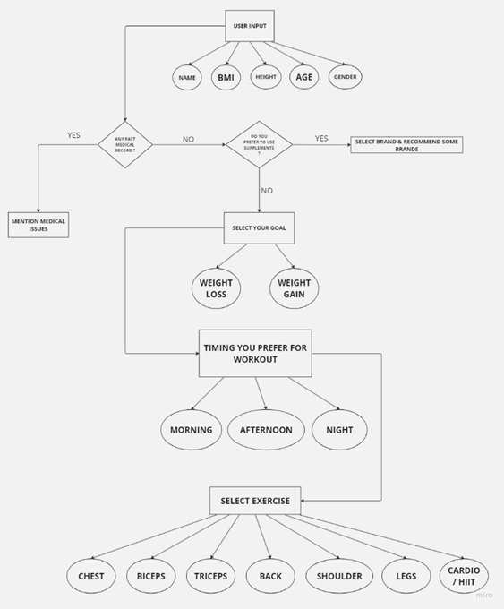
BLOCK DIAGRAM

Slide 8
03
FEATURES

Slide 9
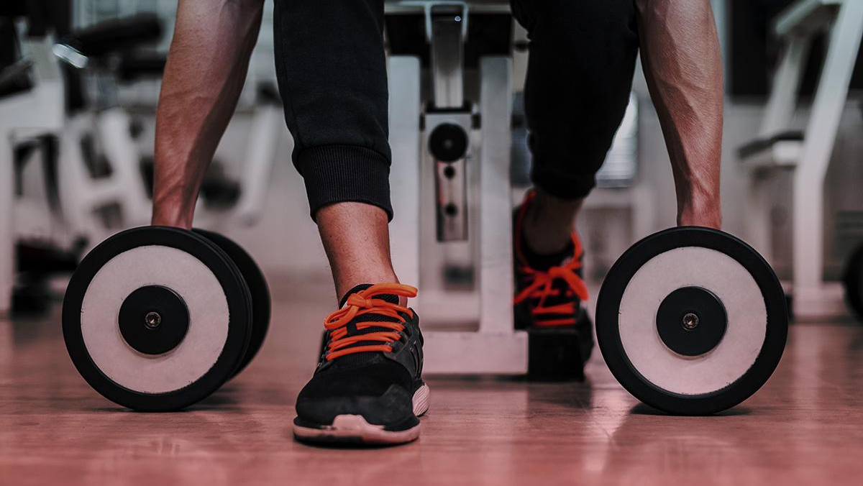
FEATURES
1.
2.
BMI Calculator
Posture Detection
3.
4.
Our own AI/ML based CHAT - BOT
Embedded Exercise Videos

Slide 10
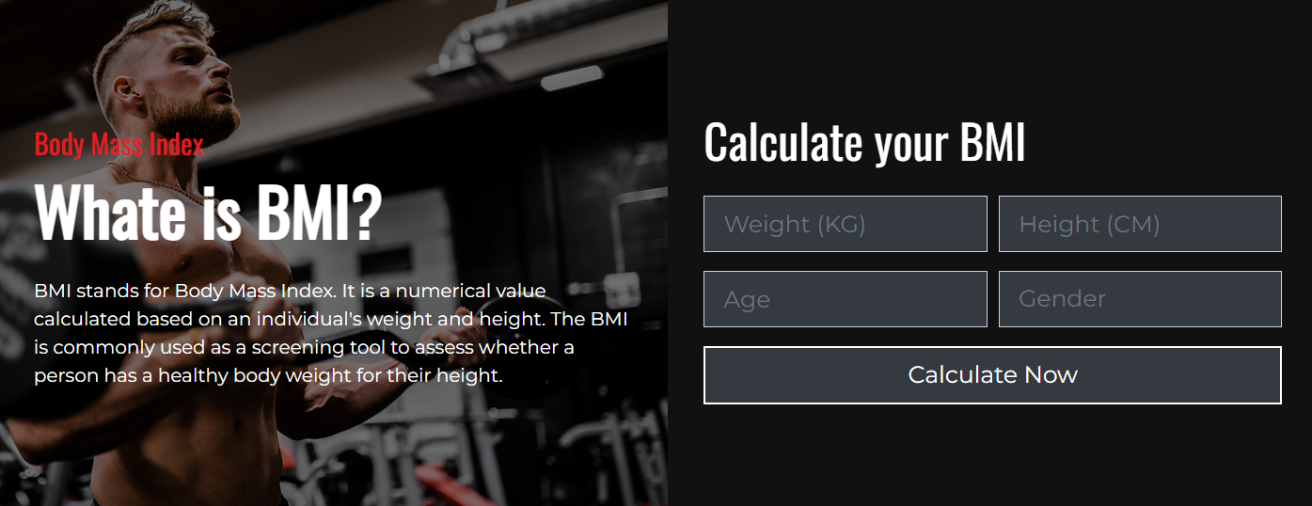
FEATURES
A BMI (Body Mass Index) calculator is a tool used to estimate a person's body fat based on their height and weight. It provides a numerical value that categorizes individuals into different BMI ranges, such as underweight, normal weight, overweight, or obese.

Slide 11
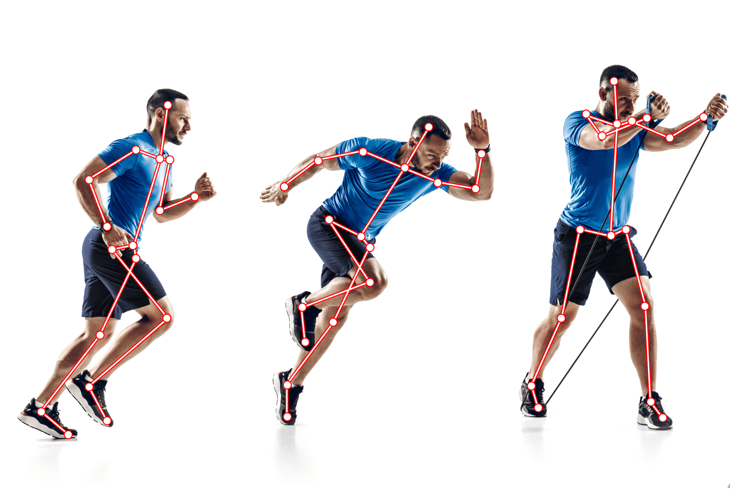
FEATURES
Our website incorporates an exercise posture detection feature. Using advanced technology, it analyzes users' movements during exercises and provides real-time feedback on their posture. This feature helps users maintain proper form, reducing the risk of injury and maximizing the effectiveness of their workouts. With exercise posture detection, our website aims to enhance the overall safety and quality of users' exercise routines, promoting better results and long-term fitness success.

Slide 12
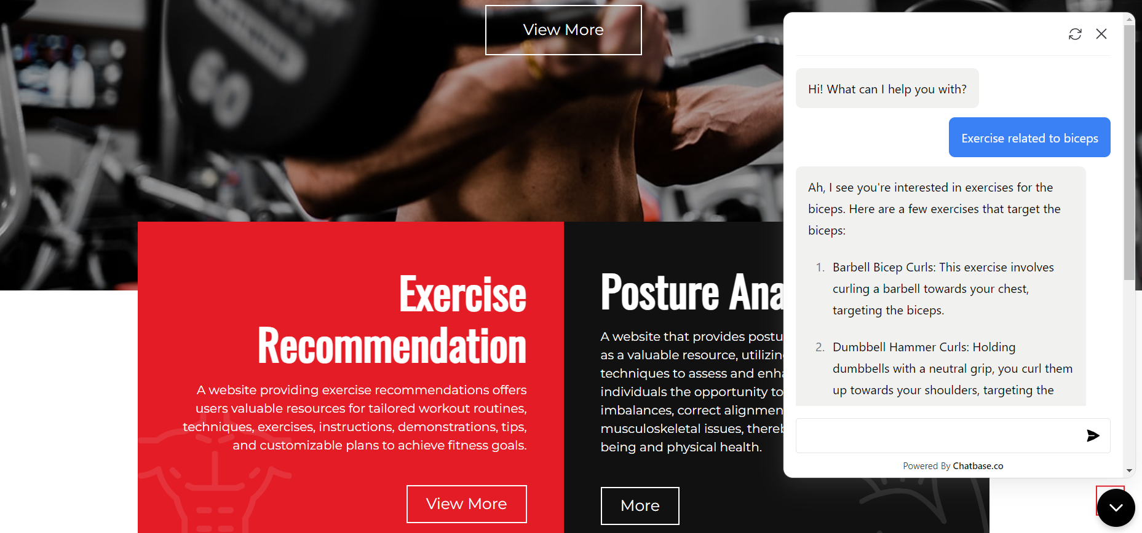
FEATURES
An AI/ML-based chatbot leverages artificial intelligence and machine learning algorithms to simulate human-like conversations. It can understand user queries, provide relevant responses, and learn from interactions to continuously improve its performance, making it a valuable tool for customer support, information retrieval, and automated assistance.

Slide 13
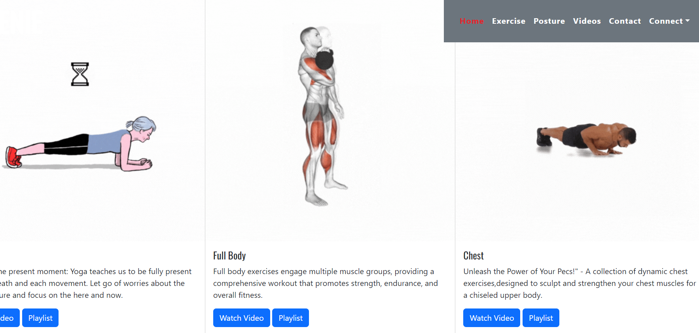
FEATURES
Our group-developed website includes a valuable feature of video recommendation for exercises targeting different body parts. This feature enhances the user experience by providing visual guidance, ensuring proper form, and enabling users to effectively target and strengthen specific areas of their body during their workouts.

Slide 14
04
ALGORITHMS

Slide 15




ALGORITHMS
Naïve Bayes
Decision Tree
Decision Tree is a machine learning algorithm that builds a tree-like model of decisions and their possible outcomes, enabling effective classification and regression analysis
Naive Bayes algorithm is a probabilistic classifier that assumes independence between features and calculates the probability of a certain class based on Bayes' theorem.
SVM
NLP
RANDOM
FOREST
Support Vector Machine (SVM) is a machine learning algorithm that separates data points by finding the optimal hyperplane to maximize the margin between different classes,
Natural Language Processing (NLP) is a field of AI that focuses on enabling computers to understand and process human language, allowing for tasks like text classification and machine translation.
Random Forest is an ensemble learning algorithm that combines multiple decision trees to make accurate predictions by reducing overfitting and increasing model performance.

Slide 16
05
RESULT & DISCUSSION

Slide 17
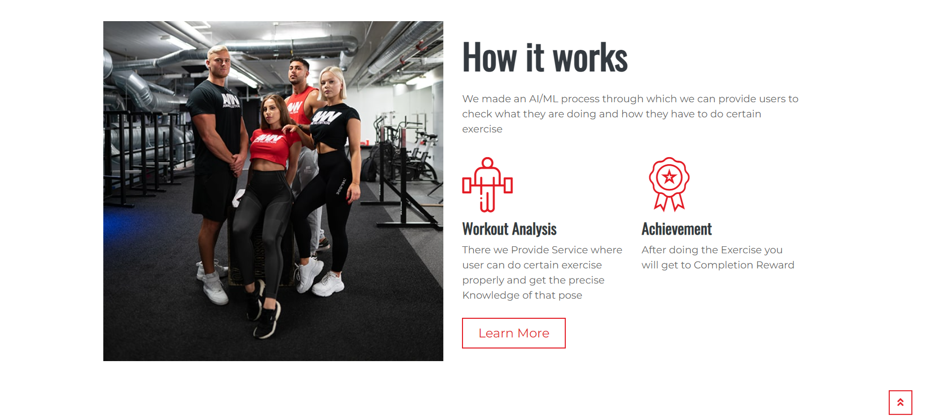
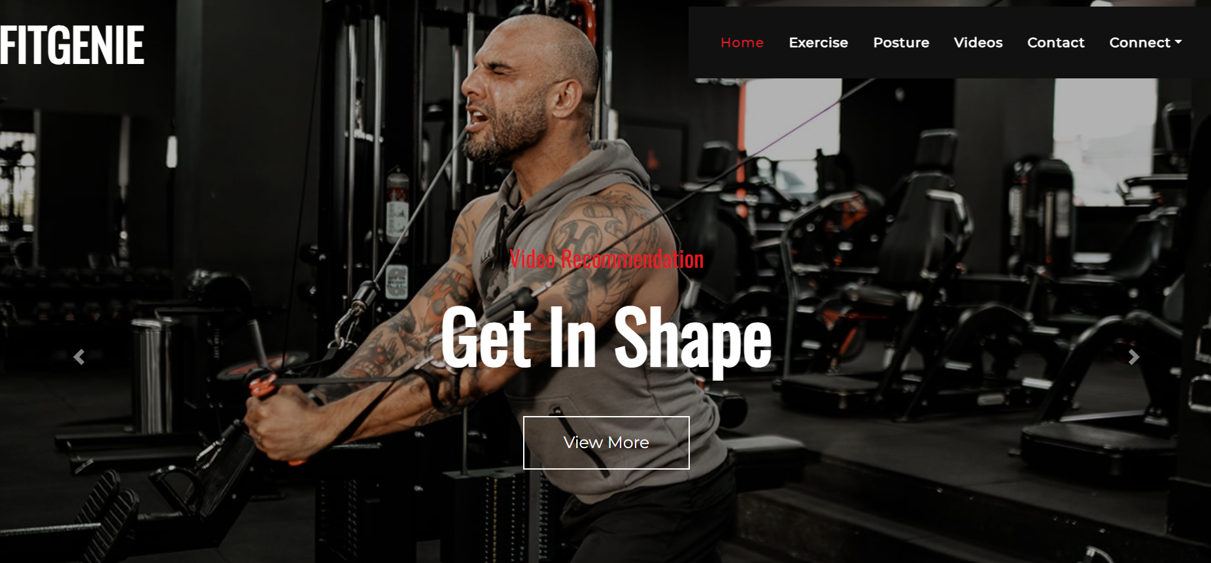
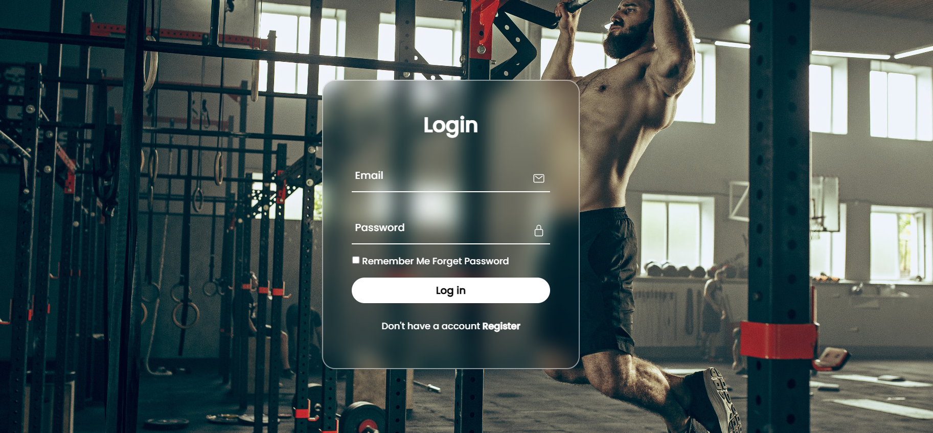
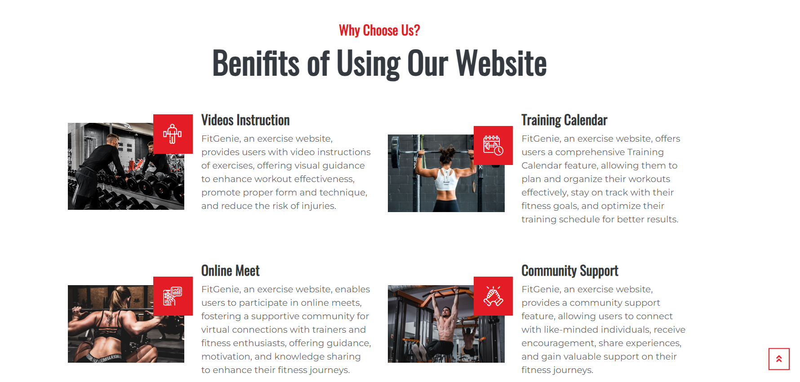
RESULT & DISCUSSION

Slide 18
06
CONCLUSION

Slide 19
CONCLUSION
PROBLEM
SOLUTION
The problem addressed in this project is the difficulty individuals face in selecting suitable exercises that align with their preferences, fitness levels, and goals. With a plethora of exercise options available, it can be overwhelming for individuals to make informed choices that cater to their specific needs.
By leveraging user preferences, historical performance data, and advanced algorithms, the system can generate personalized exercise suggestions, improving user engagement and promoting healthier lifestyles. The integration of machine learning techniques and expansion to other fitness domains offers promising avenues for future enhancements.

Slide 20
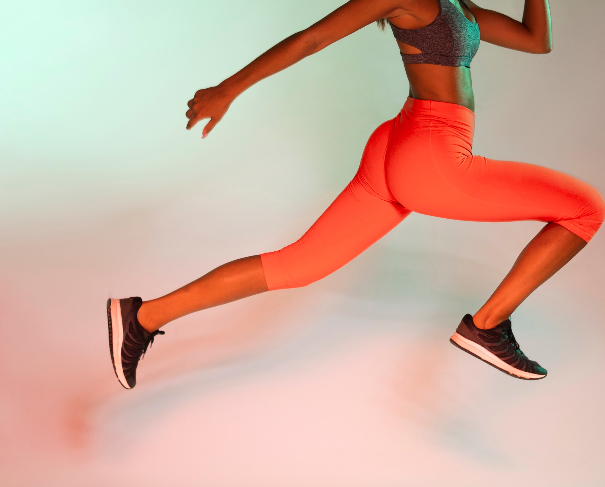
THANKS!
Do you have any questions?
PREPARED BY:
HARSH AGARWAL COMP A 01
KUNAL AGARWAL COMP A 02
HARSH DUBEY COMP A 32
ARSHAD SYED IOT A 25

